Slide 1

SILVER OAK COLLEGE OF COMPUTER APPLICATION
SUBJECT :CORE JAVA
TOPIC :UNIT -2.2 Inheritance and Interface
-PROF. SADIK LAKHANI

Slide 2
UNIT -2.2 INHERITANCE AND INTERFACE
Inheritance
Deriving classes using extends keyword
Overriding Method
Super keyword, Final keyword
Abstract class
Interface
Variables in Interface
Extending Interfaces

Slide 3
Inheritance
Inheritance is an important pillar of OOP(Object Oriented Programming). It is the mechanism in java by which one class is allow to inherit the features(fields and methods) of another class.
Important terminology:
Super Class: The class whose features are inherited is known as super class(or a base class or a parent class).
Sub Class: The class that inherits the other class is known as sub class(or a derived class, extended class, or child class). The subclass can add its own fields and methods in addition to the superclass fields and methods.
Reusability: Inheritance supports the concept of “reusability”, i.e. when we want to create a new class and there is already a class that includes some of the code that we want, we can derive our new class from the existing class. By doing this, we are reusing the fields and methods of the existing class.

Slide 4
Use of extends for inheritance
The keyword used for inheritance is extends.
Syntax :
class derived-class extends base-class
{
//methods and fields
}

Slide 5
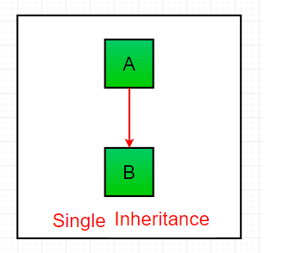
Types of Inheritance in Java
Single Inheritance : In single inheritance, subclasses inherit the features of one superclass. In image below, the class A serves as a base class for the derived class B.

Slide 6
Example
class A
{
int x,y;
void getdata(int a,int b)
{
x=a;
y=b;
}
int add()
{
System.out.println(“Superclass Method”);
return(x+y);
}
}
class B extends A
{
int mult()
{
System.out.println(“Sub-class Method”);
return(x*y);
}
}
class Test
{
public static void main(String args[])
{
B obj=new B();

Slide 7
int add,mult;
obj.getdata(5,3);
add=obj.add();
mult=obj.mult();
System.out.println(“Addition”+add);
System.out.println(“Multiplication”+mult);
}
}

Slide 8
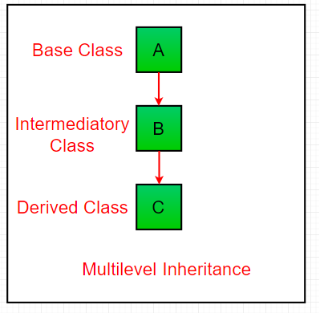
Multilevel Inheritance
In Multilevel Inheritance, a derived class will be inheriting a base class and as well as the derived class also act as the base class to other class. In below image, the class A serves as a base class for the derived class B, which in turn serves as a base class for the derived class C.

Slide 9
Example
class one
{
public void print()
{
System.out.println(“hi");
}
}
class two extends one
{
public void print1()
{
System.out.println(“hello");
}
}
class three extends two
{
public void print2()
{
System.out.println(“hi");
}
}

Slide 10
// Drived class
public class Main
{ public static void main(String[] args)
{
three g = new three();
g.print();
g.print1();
g.print2();
}
}

Slide 11
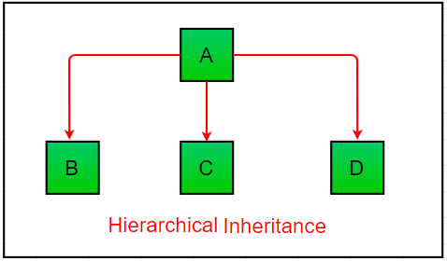
Hierarchical Inheritance
In Hierarchical Inheritance, one class serves as a superclass (base class) for more than one sub class. In below image, the class A serves as a base class for the derived class B,C and D.

Slide 12
Example
class One
{ int x=10,y=20;
void disp()
{ System.out.println(“Method of class One”);
System.out.println(“Value of X”+x);
System.out.println(“Value of Y”+y);}}
class Two extends One
{ void add()
{ System.out.println(“Method of class Two”);
System.out.println(“Addition:”+(x+y)); }}
class Three extends One
{ void mul()
{ System.out.println(“Method of class Three”);
System.out.println(“Multiplication:”+(x*y));}}

Slide 13
class Test
{
public static void main(String args[])
{
Two obj1=new Two();
Three obj2=new Three();
obj1.disp();
obj1.add();
obj2.mul();
}
}

Slide 14
Concepts of abstract class
A class that is declared using “abstract” keyword is known as abstract class. It can have abstract methods(methods without body) as well as concrete methods (regular methods with body).
A normal class(non-abstract class) cannot have abstract methods.
An abstract class can not be instantiated, which means you are not allowed to create an object of it.

Slide 15
Why we need an abstract class?
Suppose, We have a class Animal that has a method sound() and the subclasses of it like Dog, Lion, Horse, Cat etc.
Since the animal sound differs from one animal to another, there is no point to implement this method in parent class.
This is because every child class must override this method to give its own implementation details, like Lion class will say “Roar” in this method and Dog class will say “Woof”.
So when we know that all the animal child classes will override this method, then there is no point to implement this method in parent class.
Thus, making this method abstract would be the good choice as by making this method abstract we force all the sub classes to implement this method.

Slide 16
Since the Animal class has an abstract method, you must need to declare this class abstract.
Example:
abstract class Animal
{ //abstract method
public abstract void sound();
}
public class Dog extends Animal //Dog class extends Animal class
{ public void sound()
{ System.out.println("Woof"); }
public static void main(String args[]){
Dog obj = new Dog();
obj.sound(); }
}

Slide 17
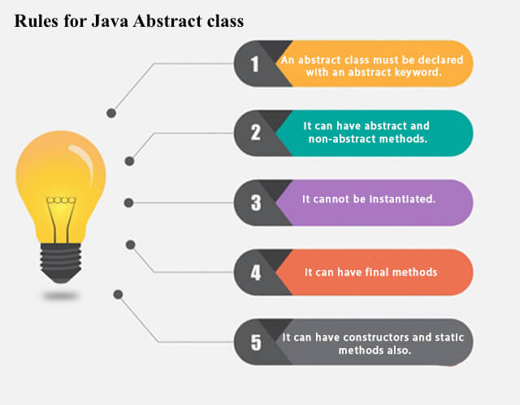

Slide 18
Why can’t we create the object of an abstract class?
Because these classes are incomplete, they have abstract methods that have no body.
There would be no actual implementation of the method to invoke.
An abstract class is like a template, so you have to extend it and build on it before you can use it.
An abstract class has no use until unless it is extended by some other class.
Key Points:
If you declare an abstract method in a class then you must declare the class abstract as well. you can’t have abstract method in a concrete class. If a class is not having any abstract method then also it can be marked as abstract.

Slide 19
It can have non-abstract method (concrete) as well.
The subclass of abstract class in java must implement all the abstract methods unless the subclass is also an abstract class.
We can access the static attributes and methods of an abstract class using the reference of the abstract class. For example,
Animal.staticMethod();

Slide 20
Difference between Abstract Class and Interface
Sr No | Abstract class | Interface
1 | Abstract class can have abstract and non-abstract methods. | Interface can have only abstract methods.
2 | Abstract class doesn't support multiple inheritance. | Interface supports multiple inheritance.
3 | Abstract class can have final, non-final, static and non-static variables. | Interface has only static and final variables.
4 | Abstract class can provide the implementation of interface. | Interface can't provide the implementation of abstract class.
5 | The abstract keyword is used to declare abstract class. | The interface keyword is used to declare interface.
6 | An abstract class can be extended using keyword "extends". | An interface can be implemented using keyword "implements".
7 | A Java abstract class can have class members like private, protected, etc. | Members of a Java interface are public by default.
8 | Example: public abstract class Shape{ public abstract void draw(); } | Example: public interface Drawable{ void draw(); }

Slide 21
When to use Abstract Methods & Abstract Class?
Abstract methods are usually declared where two or more subclasses are expected to do a similar thing in different ways through different implementations.
These subclasses extend the same Abstract class and provide different implementations for the abstract methods.
Abstract classes are used to provide implementation details of the abstract class in the subclass.

Slide 22
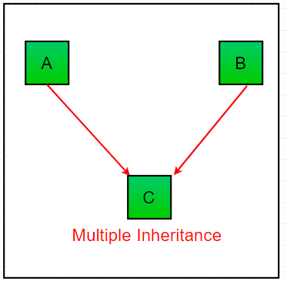
Multiple Inheritance (Interfaces)
In Multiple inheritance ,one class can have more than one superclass and inherit features from all parent classes. Please note that Java does not support multiple inheritance with classes. In java, we can achieve multiple inheritance only through Interfaces. In image below, Class C is derived from interface A and B.

Slide 23
Example
class Student
{
int m1,m2;
void getmarks(int x,int y)
{ m1=x; m2=y;
}
void putmarks()
{
System.out.println(“First”+m1);
System.out.println(“Second”+m2);
}
}

Slide 24
interface sport
{
int sp=6;
void spmarks();
}
class Result extends Student implements Sport
{
int total;
public void spmarks()
{
System.out.println(“Sport Mark”+sp);
}

Slide 25
void disp()
{
putmarks();
spmarks();
total=m1+m2+sp;
System.out.println(“Total”+total);
}
}
class Test
{
public static void main(String args[])
{ Result obj=new Result();
obj.getmarks(80,60);
obj.disp();
}
}

Slide 26
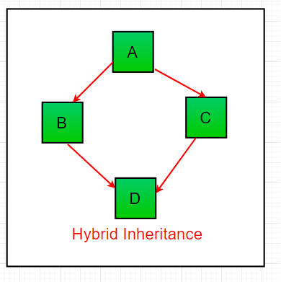
Hybrid Inheritance(Interfaces)
It is a mix of two or more of the above types of inheritance. Since java doesn’t support multiple inheritance with classes, the hybrid inheritance is also not possible with classes. In java, we can achieve hybrid inheritance only through Interfaces.

Slide 27
Polymorphism
The word polymorphism means having many forms. In simple words, we can define polymorphism as the ability of a message to be displayed in more than one form.
Real life example of polymorphism: A person at the same time can have different characteristic. Like a man at the same time is a father, a husband, an employee. So the same person posses different behaviour in different situations. This is called polymorphism.
Polymorphism is considered as one of the important features of Object Oriented Programming. Polymorphism allows us to perform a single action in different ways. In other words, polymorphism allows you to define one interface and have multiple implementations. The word “poly” means many and “morphs” means forms, So it means many forms.

Slide 28
In Java polymorphism is mainly divided into two types:
Compile time Polymorphism
Runtime Polymorphism
1.Compile time polymorphism: It is also known as static polymorphism. This type of polymorphism is achieved by function overloading or operator overloading.
Method Overloading: When there are multiple functions with same name but different parameters then these functions are said to be overloaded. Functions can be overloaded by change in number of arguments or/and change in type of arguments.

Slide 29
Example: By using different types of arguments
class MultiplyFun {
// Method with 2 parameter
int Multiply(int a, int b)
{
return a * b;
}
// Method with the same name but 2 double parameter
double Multiply(double a, double b)
{return a * b;
}
}
class Main {
public static void main(String[] args)
{ MultiplyFun f=new MultiplyFun();
System.out.println(f.Multiply(2, 4));
System.out.println(f.Multiply(5.5, 6.3)); }
}

Slide 30
Example: By using different numbers of arguments
class MultiplyFun {
// Method with 2 parameter
int Multiply(int a, int b)
{
return a * b;
}
// Method with the same name but 3 parameter
int Multiply(int a, int b, int c)
{return a * b * c;
}
}
class Main {
public static void main(String[] args)
{ MultiplyFun f=new MultiplyFun();
System.out.println(f.Multiply(2, 4));
System.out.println(f.Multiply(2, 7, 3)); }
}

Slide 31
Operator Overloading:
Java also provide option to overload operators. For example, we can make the operator (‘+’) for string class to concatenate two strings. We know that this is the addition operator whose task is to add two operands. So a single operator ‘+’ when placed between integer operands, adds them and when placed between string operands, concatenates them.In java, Only “+” operator can be overloaded:
To add integers
To concatenate strings

Slide 32
Example:
class OperatorOVERDDN {
void operator(String str1, String str2)
{
String s = str1 + str2; System.out.println("Concatinated String - "+ s);
}
void operator(int a, int b)
{
int c = a + b;
System.out.println("Sum = " + c);
}
}
class Main {
public static void main(String[] args)
{
OperatorOVERDDN obj = new OperatorOVERDDN();
obj.operator(2, 3);
obj.operator(“a", “b");
}
}

Slide 33
Runtime polymorphism: It is also known as Dynamic Method Dispatch. It is a process in which a function call to the overridden method is resolved at Runtime. This type of polymorphism is achieved by Method Overriding.
Method overriding, on the other hand, occurs when a derived class has a definition for one of the member functions of the base class. That base function is said to be overridden.
Example:
class Parent {
void Print()
{
System.out.println("parent class");
}
}

Slide 34
class subclass1 extends Parent { void Print()
{
System.out.println("subclass1");
}
}
class subclass2 extends Parent {
void Print() {System.out.println("subclass2");
}
}
class TestPolymorphism3 {
public static void main(String[] args)
{
Parent a;
a = new subclass1();
a.Print();
a = new subclass2();
a.Print();
}
}

Slide 35
super
The super keyword in java is a reference variable that is used to refer parent class objects.
The keyword “super” came into the picture with the concept of Inheritance.
Uses of super keyword
To call methods of the superclass that is overridden in the subclass.
To access attributes (fields) of the superclass if both superclass and subclass have attributes with the same name.
To explicitly call superclass no-arg (default) or parameterized constructor from the subclass constructor.

Slide 36
Use of super with variables:
This scenario occurs when a derived class and base class has same data members. In that case there is a possibility of ambiguity for the JVM.
class Vehicle /* Base class vehicle */
{ int maxSpeed = 120; }
class Car extends Vehicle /* sub class Car extending vehicle */
{ int maxSpeed = 180;
void display() /* print maxSpeed of base class (vehicle) */
{ System.out.println("Maximum Speed: " + super.maxSpeed); }
}
class Test /* Driver program to test */
{ public static void main(String[] args)
{ Car small = new Car(); small.display(); }
}

Slide 37
Use of super with methods:
This is used when we want to call parent class method. So whenever a parent and child class have same named methods then to resolve ambiguity we use super keyword.
class Person /* Base class Person */
{ void message() { System.out.println("This is person class"); }
}
class Student extends Person /* Subclass Student */
{ void message() { System.out.println("This is student class"); }
void display() // Note that display() is only in Student class
{message(); // will invoke or call current class message() method
super.message(); // will invoke or call parent class message() method }
}
class Test /* Driver program to test */
{ public static void main(String args[]) { Student s = new Student();
s.display(); // calling display() of Student }
}

Slide 38
Use of super with constructors
super keyword can also be used to access the parent class constructor. One more important thing is that, ‘’super’ can call both parametric as well as non parametric constructors depending upon the situation.
class Person /* superclass Person */
{ Person() { System.out.println("Person class Constructor"); }
}
class Student extends Person /* subclass Student extending the Person class */
{ Student() { // invoke or call parent class constructor super();
System.out.println("Student class Constructor"); }
}
class Test /* Driver program to test*/
{ public static void main(String[] args) { Student s = new Student(); }
}

